Slide 1







STACK OVERFLOW DEVELOPER SURVEY ANALYSIS
DINIL JOSHI
8th March 2024

Slide 2



OUTLINE
Executive Summary
Introduction
Methodology
Results
Visualization – Charts
Dashboard
Discussion
Findings & Implications
Conclusion
Appendix

Slide 3

EXECUTIVE SUMMARY
Data contextualization and analysis goal
Methodology description
Data gathering
Data analysis
Data visualizations
Results presentation supported with graphs and trends
Discussion of overall findings and implications regarding
the results previously exposed
Final conclusions of the carried out research

Slide 4

INTRODUCTION
Stack Overflow is a question-and-answer website for computer programmers. It is the flagship site of the Stack Exchange Network
The trends in the dataset help us to get a better understanding of the developers around the world
Results have been derived from the dataset and can’t be generalized

Slide 5

METHODOLOGY
Collection of the survey data using:
APIs
Web Scraping
Data Cleaning/Wrangling
Exploratory Data Analysis (EDA)
Data Normalization
Correlation
Data findings
Data Visualization
Presenting the key findings
Distribution, Correlations and comparison of different metrics through dashboard
Conclusion

Slide 6
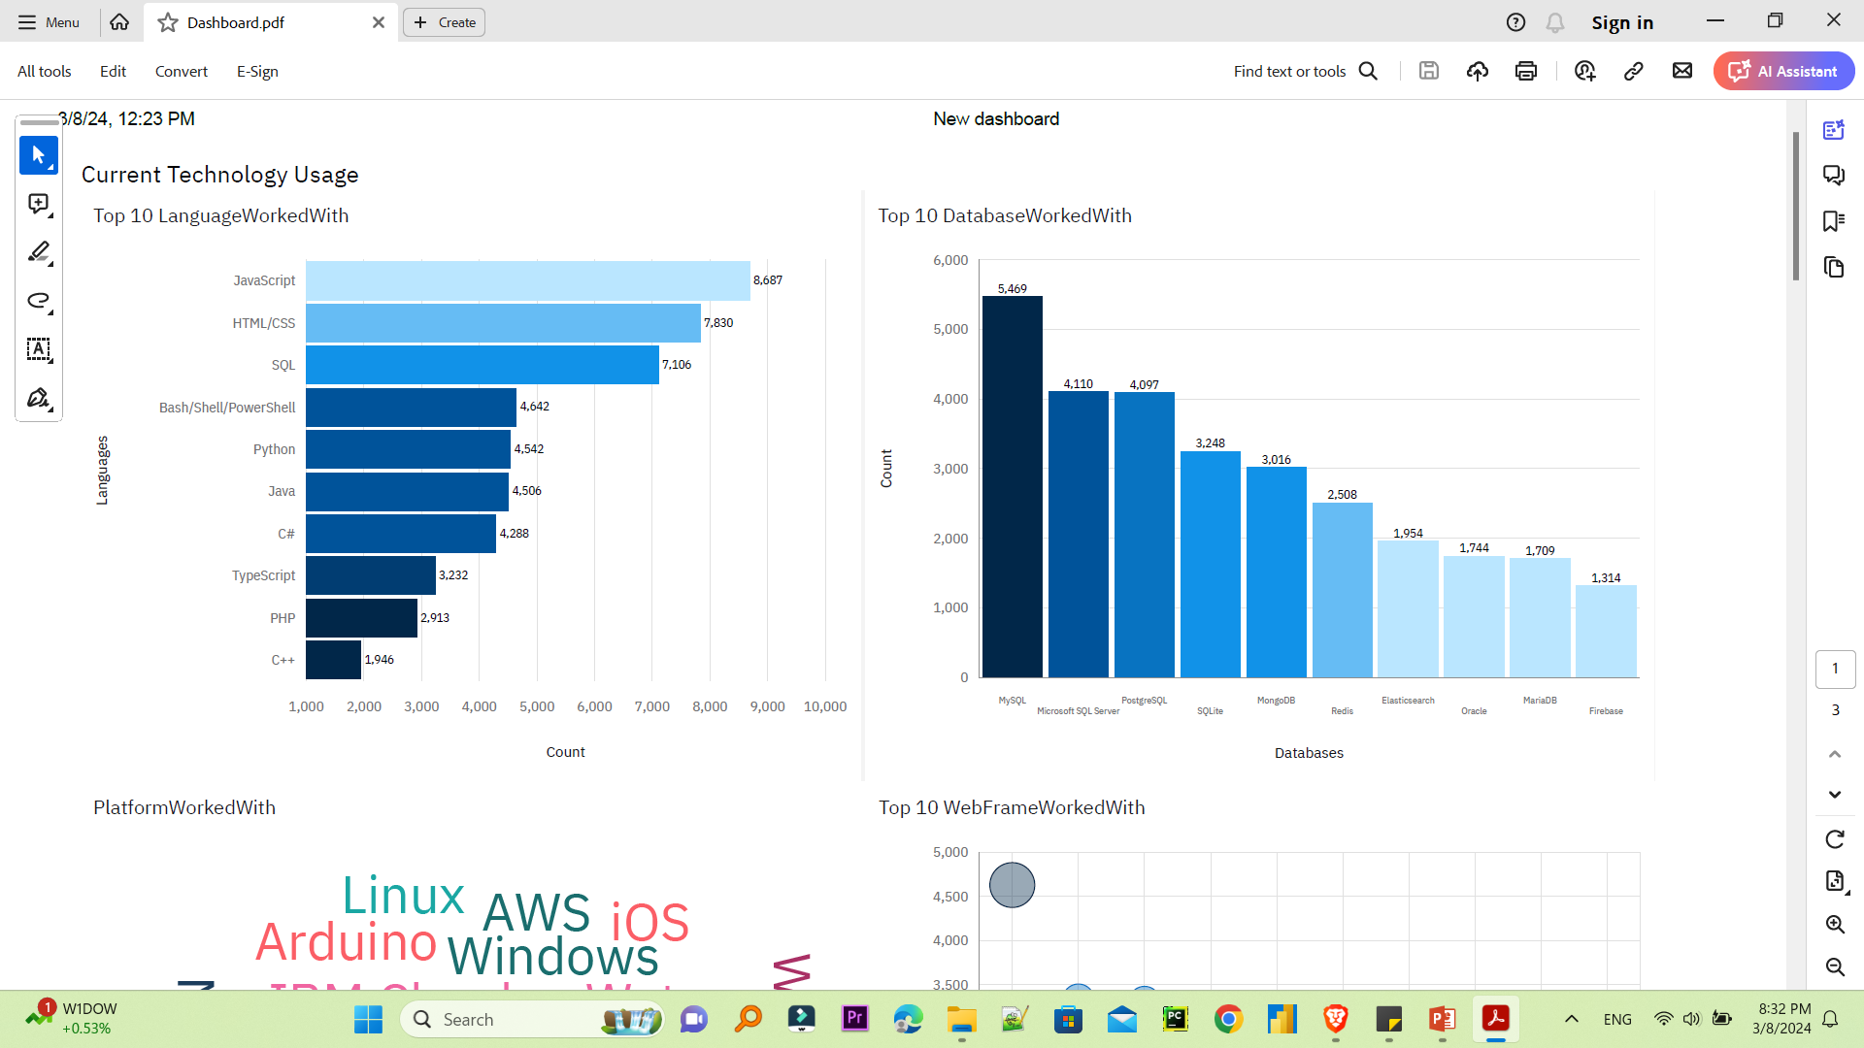
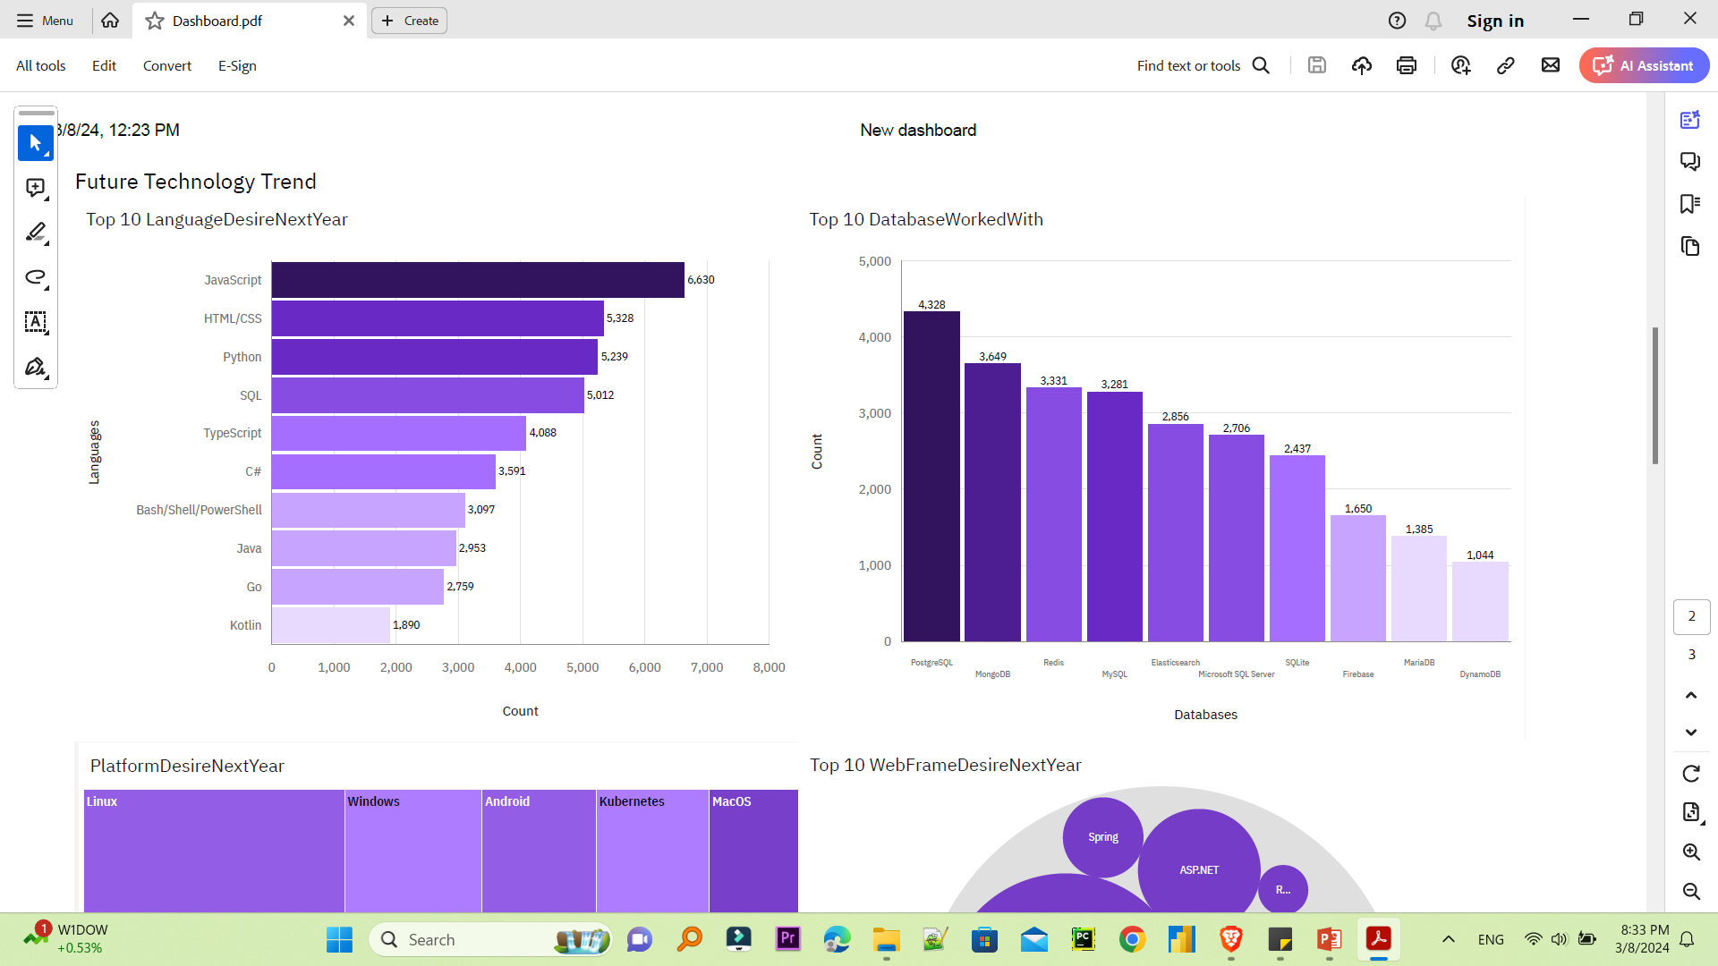
PROGRAMMING LANGUAGE TRENDS
Current Year
Next Year

Slide 7
PROGRAMMING LANGUAGE TRENDS - FINDINGS & IMPLICATIONS
Findings
JavaScript is the top programming language and also the most desired to learn
Python is also highly planned to learn
TypeScript is also highly interested to learn
Implications
Developers are still increasing who work on JavaScript, CSS/HTML and Python with TypeScript is will also start to increase in the future

Slide 8
DATABASE TRENDS
Current Year
Next Year

Slide 9
DATABASE TRENDS - FINDINGS & IMPLICATIONS
Findings
MySQL has been the most used database
PostgreSQL and MongoDB are the most desired database to learn
Implications
PostgreSQL and MongoDB are increasingly popular
SQLite might lose more of the use

Slide 10

DASHBOARD
https://github.com/Diniljoshi/IBM-DA-Capstone-Project

Slide 11
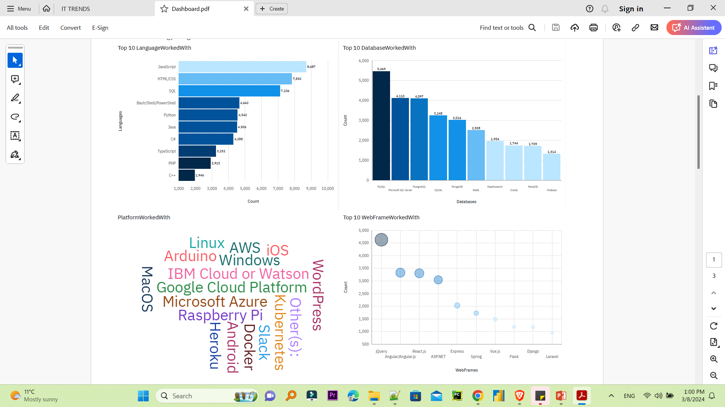
CURRENT TECHNOLOGY USAGE

Slide 12
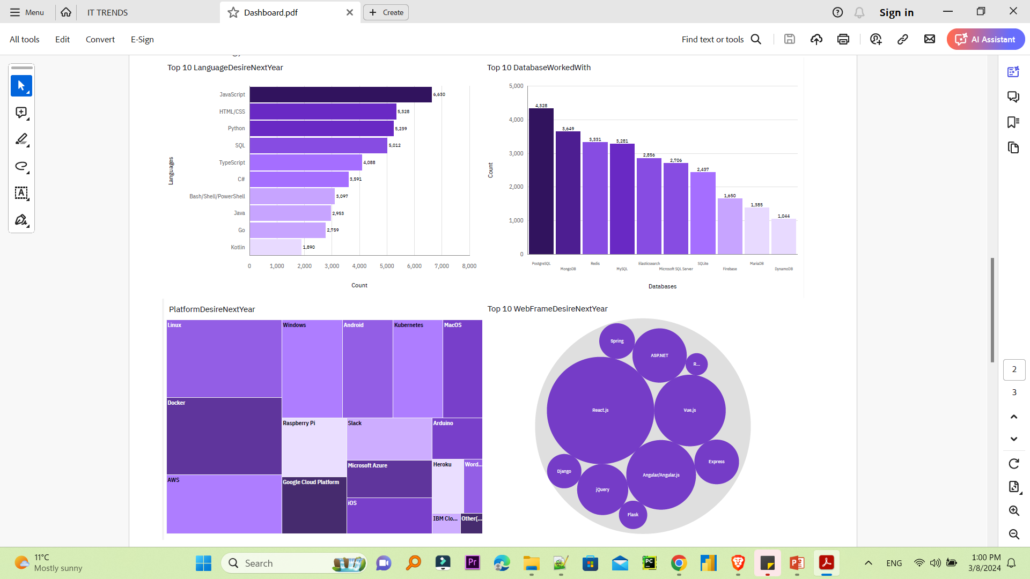
FUTURE TECHNOLOGY TREND

Slide 13
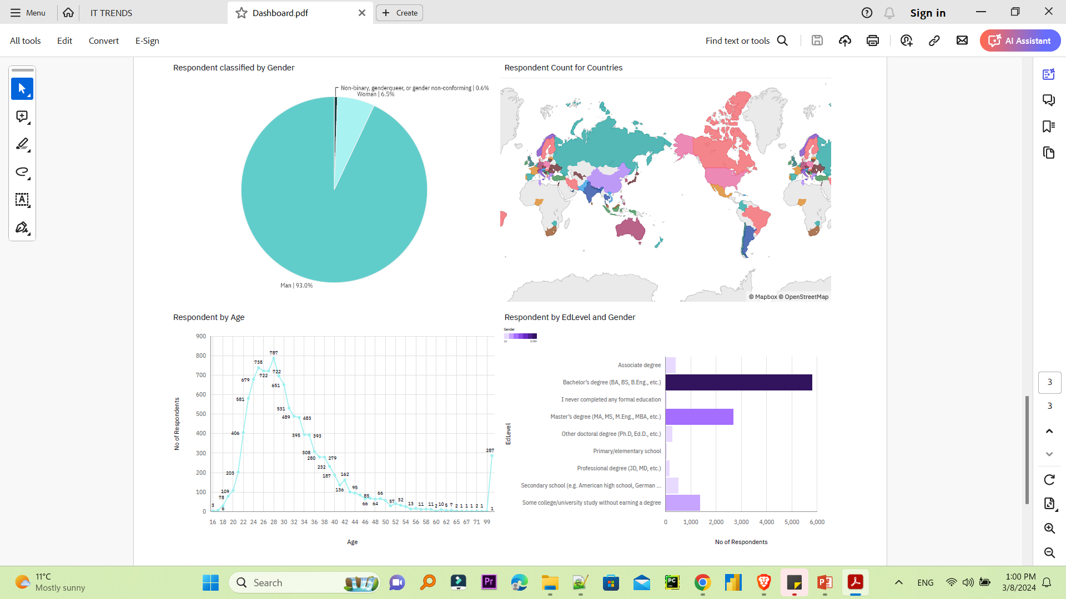
DEMOGRAPHICS

Slide 14
OVERALL FINDINGS & IMPLICATIONS
Findings
More than 90% of respondents are male
JavaScript is the most used and Python and TypeScript are increasingly popular
Respondents are mostly from the developed countries
Implications
TypeScript and MongoDB are gaining followers
Young developers without postgrad studies on its majority

Slide 15

CONCLUSION
Developers are people with very marked characteristics.
A good idea of popularity trends of different tools, platforms and languages can be obtained.
There is a job to be done to spread accessibility of this labor market to countries in development.

Slide 16
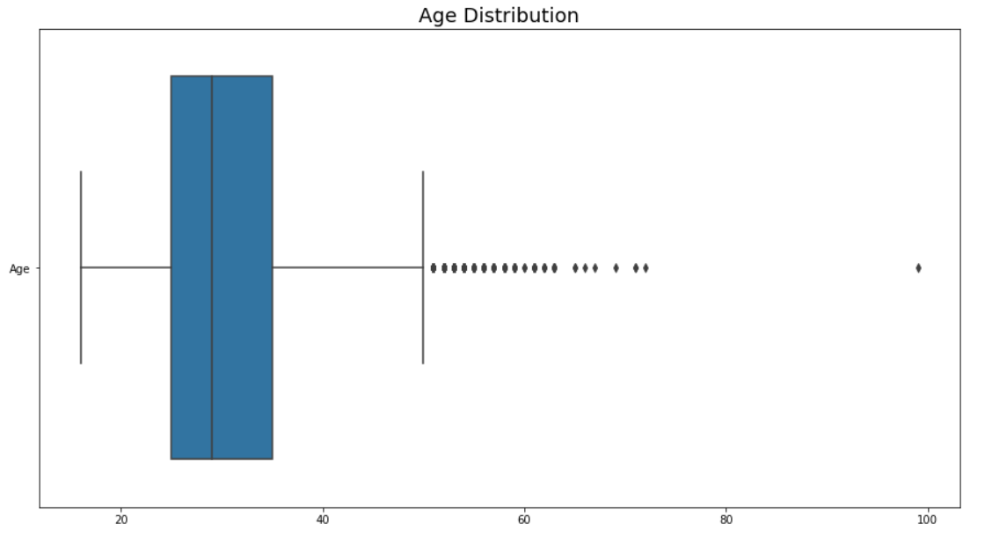

APPENDIX

Slide 17
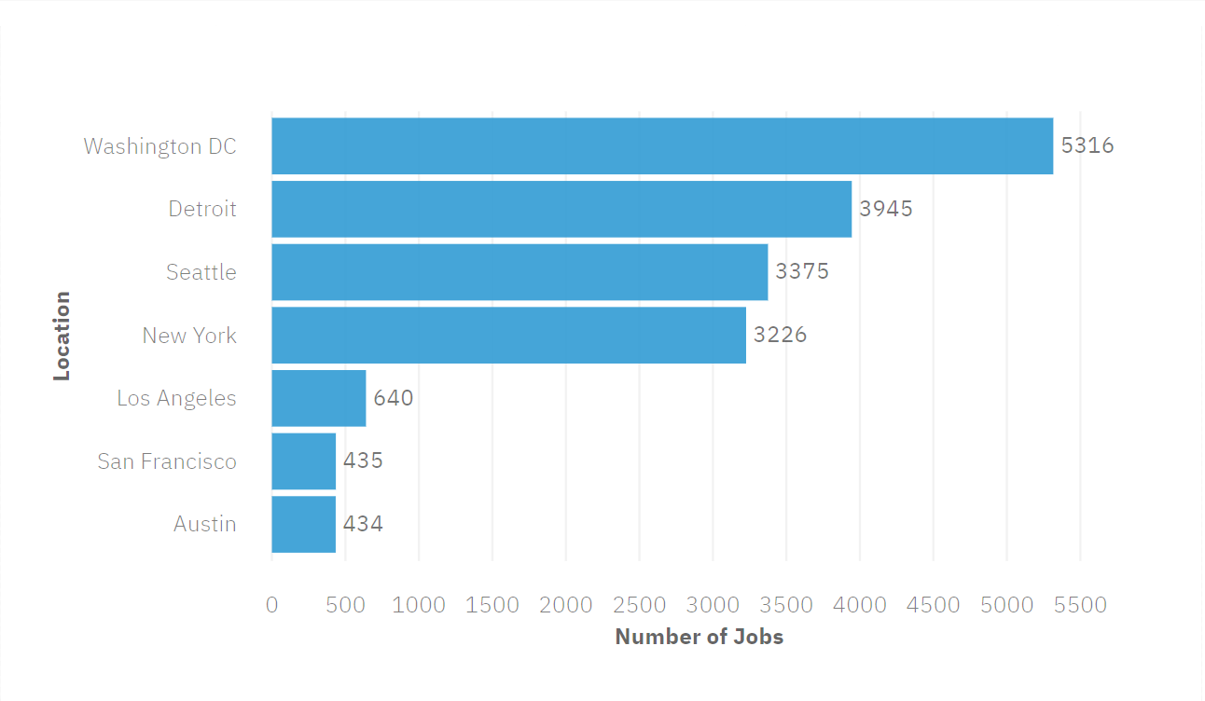
JOB POSTINGS

Slide 18
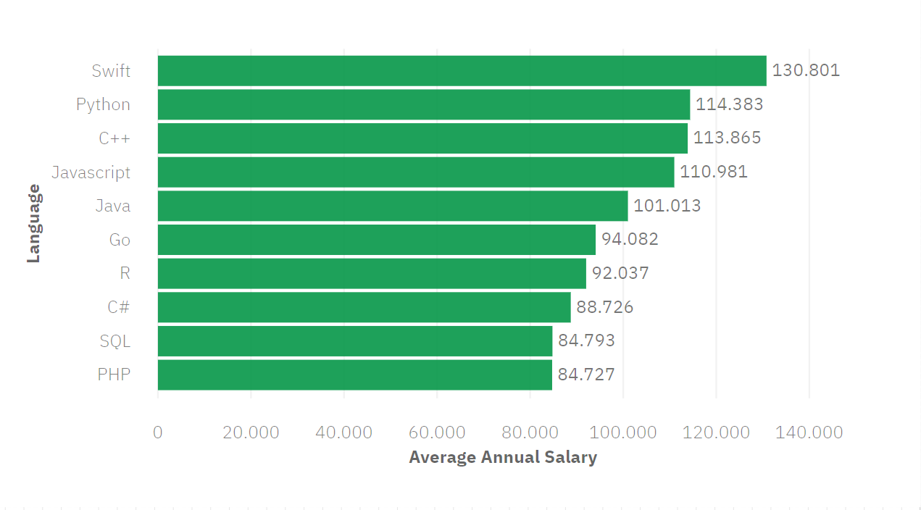
POPULAR LANGUAGES

